Slide 1


EE 359: Wireless Communications
Professor Andrea Goldsmith
Next-Gen Cellular/WiFi
Smart Homes/Spaces
Autonomous Cars
Smart Cities
Body-Area Networks
Internet of Things
All this and more …

Slide 2



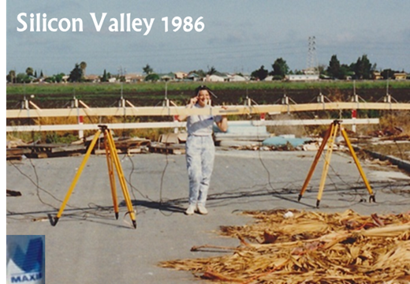
About me
Engineering prof dad, cartoonist mom
Undergrad at UC Berkeley 1982-1986
Worked in Silicon Valley 1986-1989
Fell in love with wireless.
Ph.D. from UCB: 1989-1994
Summers at AT&T Bell Labs
Taught at Caltech 1994-1999
Moved to Stanford in 1999
Lots of stuff in addition to research, teaching
Founded 2 wireless companies: Quantenna (QTNA’06) and Plume WiFi’10 Much work around diversity in STEM (in academia, industry, and IEEE)
Best Results: Daniel (22) and Nicole (20)

Slide 3
Outline
Course Basics
Course Syllabus
Wireless History
The Wireless Vision
Technical Challenges
Current/Next-Gen Wireless Systems
Spectrum Regulation and Standards
Emerging Wireless Systems (Optional Lecture)

Slide 4
Course Information* People
Instructor: Andrea Goldsmith, Pack 371, andrea@ee, OHs: TTh immediately after class and by appt.
TA: Tom Dean (trdean@stanford.edu)
Discussion section: Wed 4-5 pm (hopefully taped)
OHs: Wed 5-6pm, Th 4-5pm, Fri 11-12pm (tentative). Emails received during OHs will be responded to during or just after. Email questions are ideally via Piazza.
Piazza: https://piazza.com/stanford/win2020/ee359/home. All are registered, will use to poll on OH/discussion times
Class Administrator: Dash Corbett, email: dashiellcorbett@stanford.edu, 365 Packard, 723-2681. Homework dropoff: Fri by 4 pm.
*See web or handout for more details

Slide 5
Course Information Nuts and Bolts
Prerequisites: EE279 or equivalent (Digital Communications)
Textbook: Wireless Communications (by me), draft 2nd Ed.
Available as reader at bookstore or on website
Raffle for $100 Amazon gift card for typos/mistakes/suggestions
Supplemental texts at Engineering Library.
Class Homepage: www.stanford.edu/class/ee359
All announcements, handouts, homeworks, etc. posted to website
“Lectures” link continuously updates topics, handouts, and reading
Calendar will show any changes to class/OH/discussion times
Class Mailing List: ee359-win1920-students@lists (automatic for on-campus registered students).
Guest list ee359-win1920-guest@lists for SCPD and auditors: send Tom email to sign up.
Sending mail to ee359-win1920-staff@lists reaches me and Tom.

Slide 6
Course Information Policies
Grading: Two Options
No Project (3 units): HW – 25%, 2 Exams – 35%, 40%
Project (4 units): HWs- 20%, Exams - 25%, 30%, Project - 25%
HWs: assigned Thu, due following Fri 4pm (starts next week)
Homeworks lose 33% credit after 4pm Fri, lowest HW dropped
Up to 3 students can collaborate and turn in one HW writeup
Collaboration means all collaborators work out all problems together
Unpermitted collaboration or aid (e.g. solns for the book or from prior years) is an honor code violation and will be dealt with strictly.
Extra credit: up to 2 “design your own” HW problems; course eval
Exams:
Midterm week of 2/17 (It will be scheduled outside class time; the duration is 2 hours.) Final on 3/17 from 3:30-6:30pm (pizza after)
Exams must be taken at scheduled time (with very few exceptions)

Slide 7
Course Information Projects
The term project (for students electing to do a project) is a research project related to any topic in wireless
Two people may collaborate if you convince me the sum of the parts is greater than each individually
A 1 page proposal is due 2/7 at midnight.
5-10 hours of work typical for proposal
Must create project website and post proposal there (submit web link)
Preliminary proposals can be submitted for early feedback
The project is due by midnight on 3/14 (on website)
20-40 hours of work after proposal is typical for a project
Suggested topics in project handout
Anything related to wireless or application of wireless techniques ok.

Slide 8
Course Syllabus
Overview of Wireless Communications
Path Loss, Shadowing, and Fading Models
Capacity of Wireless Channels
Digital Modulation and its Performance
Adaptive Modulation
Diversity
MIMO Systems
Multicarrier Systems: OFDM and other waveforms
Multiuser and Cellular Systems

Slide 9
Tentative Detailed Syllabus
Lecture # | Date | Topic | Required Reading
 |  | Introduction
1 | 1/7 | Overview of Wireless Communications | Chapter 1
Wireless Channel Models
2-3 | 1/9, 1/14 | Path Loss and Shadowing Models, Millimeter wave propagation | Chapter 2
4-5 | 1/17, 1/21 | Statistical Fading Models, Narrowband Fading | Section 3.1-3.2.3
6 | 1/23 | Wideband Fading Models | Section 3.3
Impact of Fading and ISI on Wireless Performance
7 | 1/28 | Capacity of Wireless Channels |  | Chapter 4
8,9,10 | 1/30, 2/5, 2/6 | Digital Modulation and its Performance |  | Lec 8: Chapter 5 Lec 9-10: Chapter 6
Flat-Fading Countermeasures
11 | 2/11 | Diversity |  | Chapter 7
MT | Week of 2/17 | Midterm (outside class time) | Chapters 2 to 7
12-13 | 2/13-2/18 | Adaptive Modulation |  | Chapter 9.1-9.3
14-15 | 2/21-2/25 | Multiple Input/Output Systems (MIMO) | Chapter 10, Appendix C
ISI Countermeasures
16-17 | 2/27, 3/3 | Multicarrier Systems, OFDM, and other multicarrier waveforms | Chapter 12
18-19 | 3/4-3/10 | Multiuser and Cellular Systems | Topics in Chapters 13-15
Course Summary
20 | 3/12 | Course summary/final review (and optional advanced topics lecture over lunch)
Final | 3/17 | 3:30-6:30pm | Pizza party to follow

Slide 10
Class Rescheduling
No lectures Thu 1/16, Tue 2/4, Thu 2/20 and Thu 3/5.
These lectures are tentatively rescheduled as:
Lecture on Thu 1/16 is rescheduled to Fri 1/17 at lunch
Lecture on Tue 2/4 is rescheduled to Wed 2/5 at lunch
Lecture on Thu 2/20 is rescheduled to Fri 2/21 at lunch
Lecture on Thu 3/5 is rescheduled to Wed 3/4 at lunch
Last lecture on 3/12 has an optional component 11:50-12:30 on advanced topics with lunch.

Slide 11
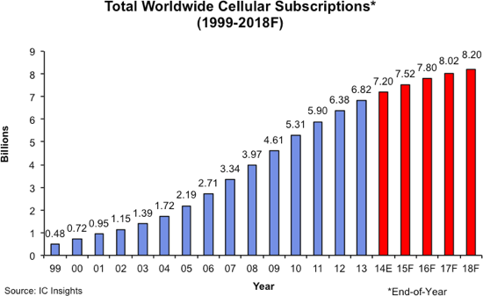
Wireless History
Ancient Systems: Smoke Signals, Carrier Pigeons, …
Radio invented in the 1880s by Marconi
Many sophisticated military radio systems were developed during and after WW2
Exponential growth in cellular use since 1988: approx. 8B worldwide users today
Ignited the wireless revolution
Voice, data, and multimedia ubiquitous
Use in 3rd world countries growing rapidly
Wifi also enjoying tremendous success and growth
Bluetooth pervasive, satellites also widespread

Slide 12
Future Wireless Networks
Ubiquitous Communication Among People and Devices
Next-Gen Cellular/WiFi
Smart Homes/Spaces
Autonomous Cars
Smart Cities
Body-Area Networks
Internet of Things
All this and more …

Slide 13
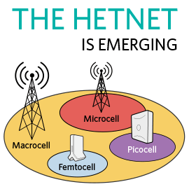



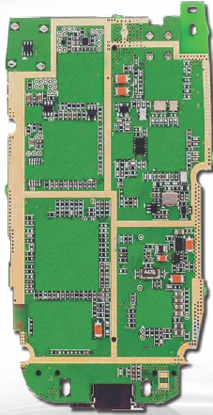
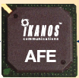
Challenges
Network/Radio Challenges
Gbps data rates with “no” errors
Energy efficiency
Scarce/bifurcated spectrum
Reliability and coverage
Heterogeneous networks
Seamless internetwork handoff
5-6G
AdHoc
Short-Range
Device/SoC Challenges
Performance
Complexity
Size, Power, Cost, Energy
High frequencies/mmWave
Multiple Antennas
Multiradio Integration
Coexistance
BT
Radio
Cellular
GPS
Cog
Mem
WiFi
CPU
mmW

Slide 14
Software-Defined (SD) Radio:
Is this the solution to the device challenges?
BT
FM/XM
A/D
Cellular
GPS
A/D
DVB-H
DSP
Apps
Processor
A/D
WLAN
Media
Processor
Wimax
A/D
Wideband antennas and A/Ds span BW of desired signals
DSP programmed to process desired signal: no specialized HW
Today, this is not cost, size, or power efficient
SubNyquist sampling may help with the A/D and DSP requirements

Slide 15
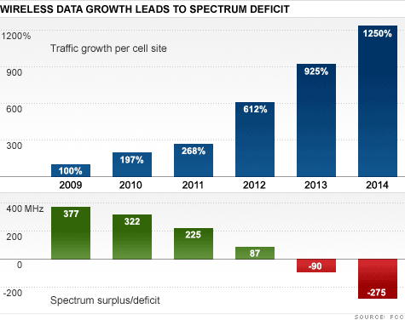
“Sorry America, your airwaves are full*”
Exponential Mobile Data Growth
Leading to massive spectrum deficit
Source: FCC

Slide 16
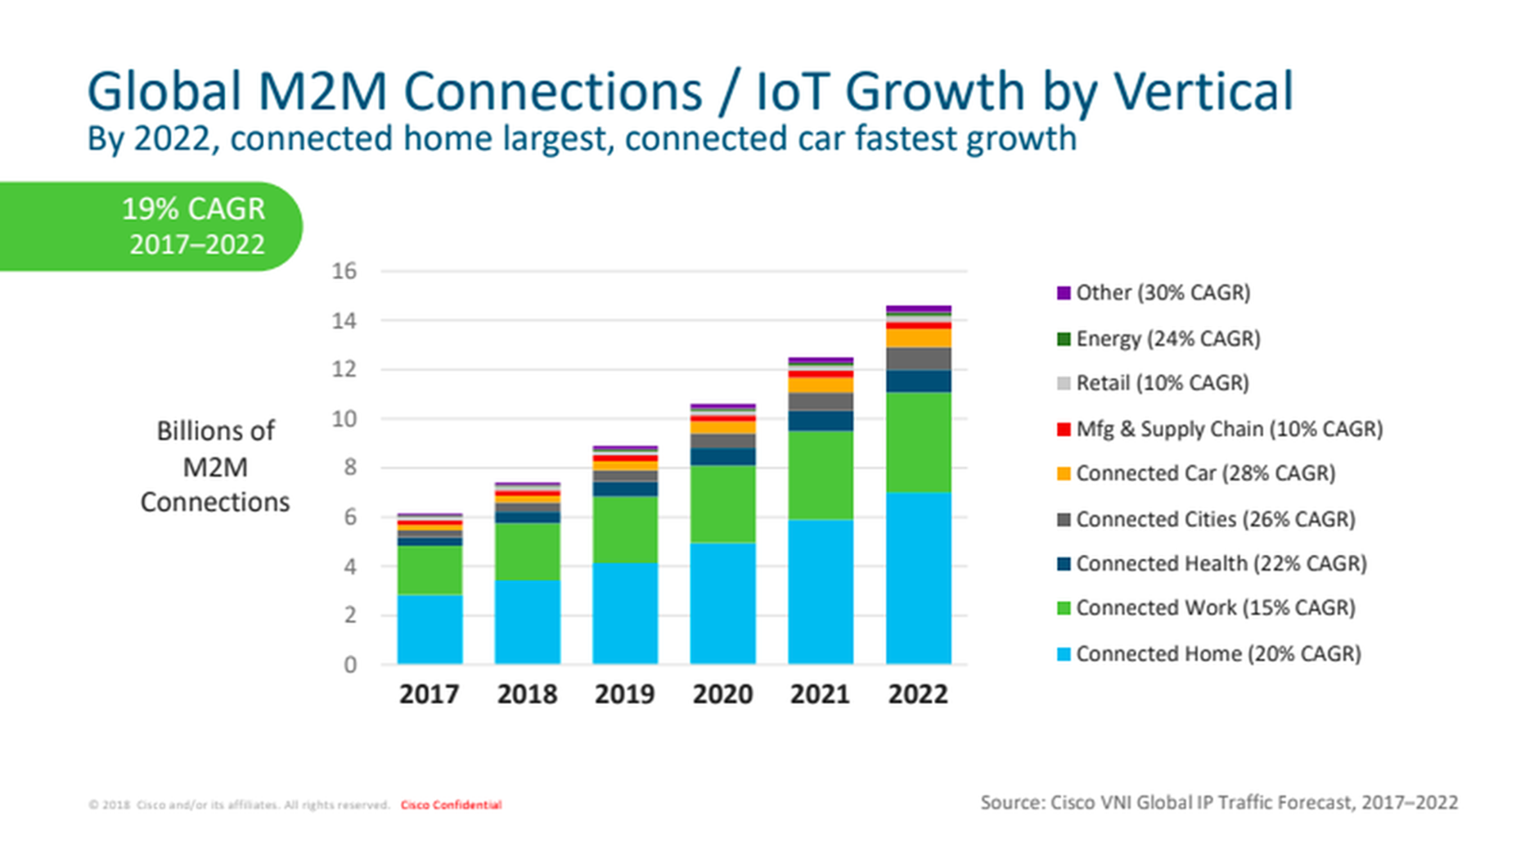
On the Horizon, the Internet of Things

Slide 17
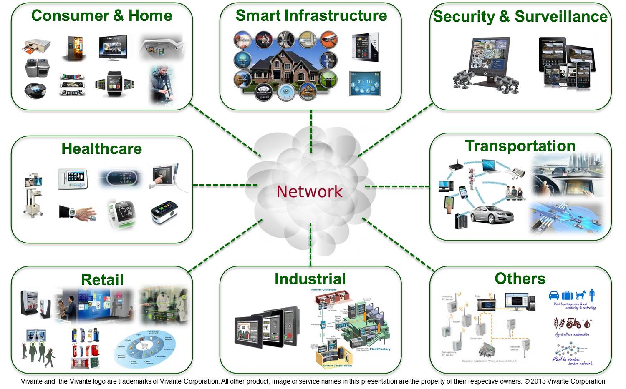
What is the Internet of Things:
Enabling every electronic device to be connected to each other and the Internet
Includes smartphones, consumer electronics, cars, lights, clothes, sensors, medical devices,…
Value in IoT is data processing in the cloud
Different requirements than smartphones: low rates/energy consumption

Slide 18
Are we at the Shannon limit of the Physical Layer?
We are at the Shannon Limit
“The wireless industry has reached the theoretical limit of how fast networks can go” K. Fitcher, Connected Planet
“We’re 99% of the way” to the “barrier known as Shannon’s limit,” D. Warren, GSM Association Sr. Dir. of Tech.
Shannon was wrong, there is no limit
“There is no theoretical maximum to the amount of data that can be carried by a radio channel” M. Gass, 802.11 Wireless Networks: The Definitive Guide
“Effectively unlimited” capacity possible via personal cells (pcells). S. Perlman, Artemis.

Slide 19
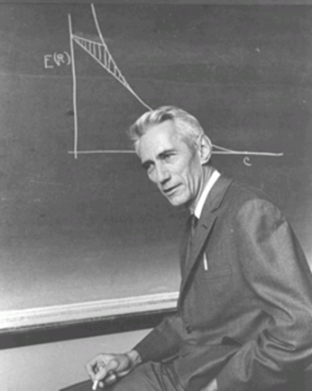
What would Shannon say?
We don’t know the Shannon capacity of most wireless channels
Time-varying channels.
Channels with interference or relays.
Cellular systems
Ad-hoc and sensor networks
Channels with delay/energy/$$$ constraints.
Shannon theory provides design insights
and system performance upper bounds

Slide 20
Current/Next-Gen Wireless Systems
Current:
4G Cellular Systems (LTE-Advanced)
6G Wireless LANs/WiFi (802.11ax)
mmWave massive MIMO systems
Satellite Systems
Bluetooth
Zigbee
WiGig
Emerging
5G Cellular and 7G WiFi Systems
Ad/hoc and Cognitive Radio Networks
Energy-Harvesting Systems
Chemical/Molecular
Much room
For innovation

Slide 21
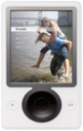
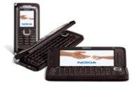
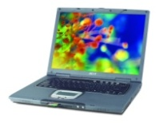
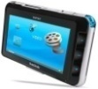
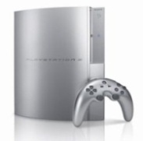

Spectral Reuse
Due to its scarcity, spectrum is reused
In licensed bands
and unlicensed bands
BS
Cellular
Wifi, BT, UWB,…
Reuse introduces interference

Slide 22
Cellular Systems: Reuse channels to maximize capacity
Geographic region divided into cells
Freq./timeslots/codes/space reused in different cells (reuse 1 common).
Interference between cells using same channel: interference mitigation key
Base stations/MTSOs coordinate handoff and control functions
Shrinking cell size increases capacity, as well as complexity, handoff, …
BASE
STATION
MTSO

Slide 23
4G/LTE Cellular
Much higher data rates than 3G (50-100 Mbps)
3G systems has 384 Kbps peak rates
Greater spectral efficiency (bits/s/Hz)
More bandwidth, adaptive OFDM-MIMO, reduced interference
Flexible use of up to 100 MHz of spectrum
10-20 MHz spectrum allocation common
Low packet latency (<5ms).
Reduced cost-per-bit (not clear to customers)
All IP network

Slide 24
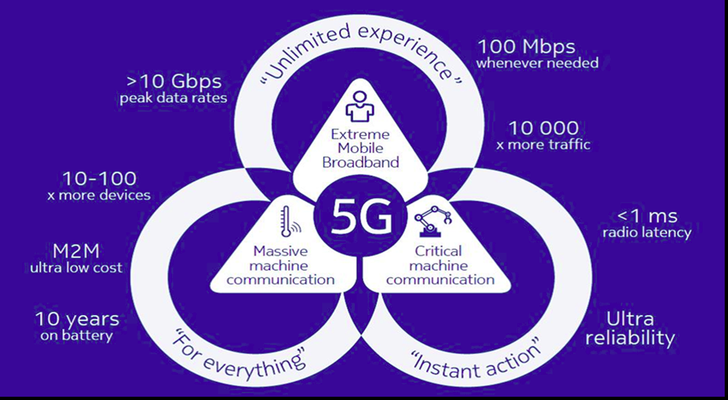
5G Upgrades from 4G

Slide 25

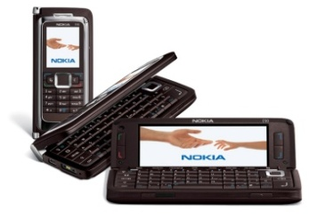
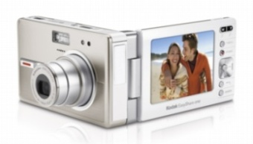
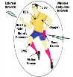
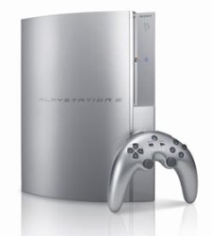
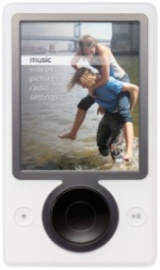
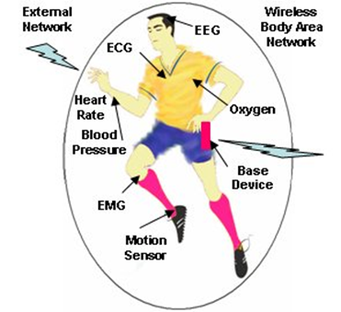
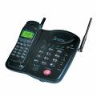
Future Cellular Phones
Burden for this performance is on the backbone network
Everything wireless in one device
San Francisco
BS
BS
LTE backbone is the Internet
Internet
Paris
N^{th}-Gen
Cellular
Phone
System
N^{th}-Gen
Cellular
BS
Much better performance and reliability than today
- Gbps rates, low latency, 99% coverage, energy efficiency

Slide 26
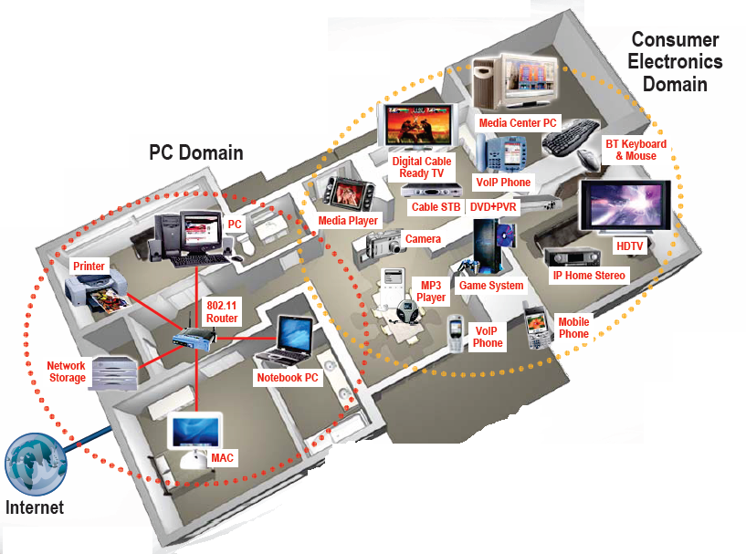
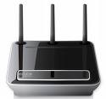

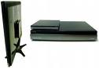
Wifi Networks Multimedia Everywhere, Without Wires
802.11ac
Streaming video
Gbps data rates
High reliability
Coverage inside and out
Wireless HDTV
and Gaming

Slide 27
Wireless LAN Standards
802.11b (Old – 1990s)
Standard for 2.4GHz ISM band (80 MHz)
Direct sequence spread spectrum (DSSS)
Speeds of 11 Mbps, approx. 500 ft range
802.11a/g (Middle Age– mid-late 1990s)
Standard for 5GHz band (300 MHz)/also 2.4GHz
OFDM in 20 MHz with adaptive rate/codes
Speeds of 54 Mbps, approx. 100-200 ft range
802.11n/ac/ax or Wi-Fi 6 (current gen)
Standard in 2.4 GHz and 5 GHz band
Adaptive OFDM /MIMO in 20/40/80/160 MHz
Antennas: 2-4, up to 8
Speeds up to 1 Gbps (10 Gbps for ax), approx. 200 ft range
Other advances in packetization, antenna use, multiuser MIMO
Many
WLAN
cards
have many generations

Slide 28
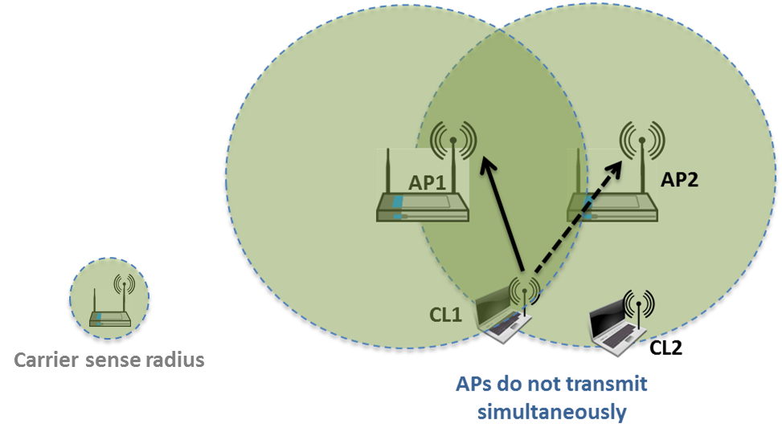
Why does WiFi performance suck?
Carrier Sense Multiple Access:
if another WiFi signal
detected, random backoff
Collision Detection: if collision
detected, resend
The WiFi standard lacks good mechanisms to mitigate interference, especially in dense AP deployments
Multiple access protocol (CSMA/CD) from 1970s
Static channel assignment, power levels, and sensing thresholds
In such deployments WiFi systems exhibit poor spectrum reuse and significant contention among APs and clients
Result is low throughput and a poor user experience
Multiuser MIMO will help each AP, but not interfering APs

Slide 29
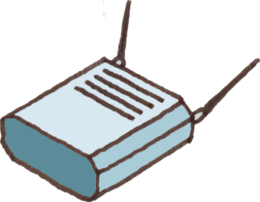
Self-Organizing Networks for WiFi
- Channel Selection
- Power Control
- etc.
SoN
Controller
SoN-for-WiFi: dynamic self-organization network software to manage of WiFi APs.
Allows for capacity/coverage/interference mitigation tradeoffs.
Also provides network analytics and planning.

Slide 30
Satellite Systems
Cover very large areas
Different orbit heights
Orbit height trades off coverage area for latency
GEO (39000 Km) vs MEO (9000 km) vs LEO (2000 Km)
Optimized for one-way transmission
Radio (XM, Sirius) and movie (SatTV, DVB/S) broadcasts
Most two-way LEO systems went bankrupt in 1990s-2000s
LEOs have resurfaced with 4G to bridge digital divide
Global Positioning System (GPS) ubiquitous
Satellite signals used to pinpoint location
Popular in cell phones, PDAs, and navigation devices

Slide 31
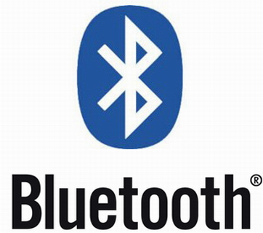

Bluetooth
Cable replacement RF technology (low cost)
Short range (10m, extendable to 100m)
2.4 GHz band (crowded)
1 Data (700 Kbps) and 3 voice channels, up to 3 Mbps
Widely supported by telecommunications, PC, and consumer electronics companies
Few applications beyond cable replacement
8C32810.61-Cimini-7/98

Slide 32
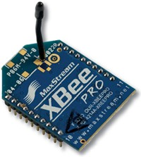
IEEE 802.15.4/ZigBee Radios
Low-rate low-power low-cost secure radio
Complementary to WiFi and Bluetooth
Frequency bands: 784, 868, 915 MHz, 2.4 GHz
Data rates: 20Kbps, 40Kbps, 250 Kbps
Range: 10-100m line-of-sight
Support for large mesh networking or star clusters
Support for low latency devices
CSMA-CA channel access
Applications: light switches, electricity meters, traffic management, and other low-power sensors.

Slide 33
Spectrum Regulation
Spectrum a scarce public resource, hence allocated
Spectral allocation in US controlled by FCC (commercial) or OSM (defense)
FCC auctions spectral blocks for set applications.
Some spectrum set aside for universal use
Worldwide spectrum controlled by ITU-R
Regulation is a necessary evil.
Innovations in regulation being considered worldwide
in multiple cognitive radio paradigms

Slide 34
Standards
Interacting systems require standardization
Companies want their systems adopted as standard
Alternatively try for de-facto standards
Standards determined by TIA/CTIA in US
IEEE standards often adopted
Process fraught with inefficiencies and conflicts
Worldwide standards determined by ITU-T
In Europe, ETSI is equivalent of IEEE
Standards for current systems summarized in text Appendix D.

Slide 35
Emerging Systems
Advanced Topics Lecture: See Backup Slides
New cellular system architectures
mmWave/massive MIMO communications
Software-defined network architectures
Ad hoc/mesh wireless networks
Cognitive radio networks
Wireless sensor networks
Energy-constrained radios
Distributed control networks
Chemical Communications
Applications of Communications in Health, Bio-medicine, and Neuroscience

Slide 36
Main Points
The wireless vision encompasses many exciting applications
Technical challenges transcend all system design layers
5G networks must support higher performance for some users, extreme energy efficiency and/or low latency for others
Cloud-based software to dynamically control and optimize wireless networks needed (SDWN)
Innovative wireless design needed for 5G cellular/WiFi, mmWave systems, massive MIMO, and IoT connectivity
Standards and spectral allocation heavily impact the evolution of wireless technology

Slide 37
Backup Slides: Emerging Systems

Slide 38
Rethinking “Cells” in Cellular
How should cellular
systems be designed for
Capacity
Coverage
Energy efficiency
Low latency
Coop
MIMO
Small
Cell
Relay
DAS
Traditional cellular design “interference-limited”
MIMO/multiuser detection can remove interference
Cooperating BSs form a MIMO array: what is a cell?
Relays change cell shape and boundaries
Distributed antennas move BS towards cell boundary
Small cells create a cell within a cell
Mobile cooperation via relays, virtual MIMO, network coding.

Slide 39

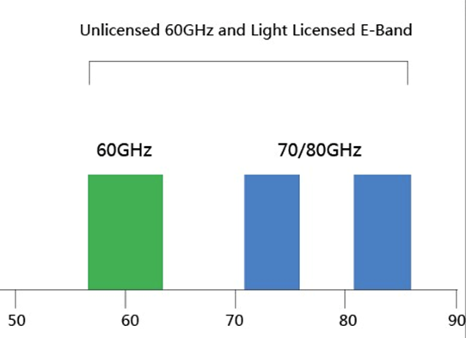
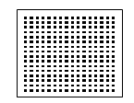
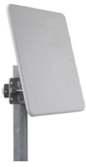
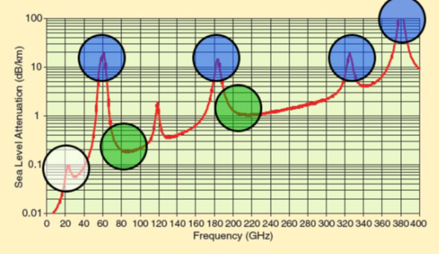
mmWave Massive MIMO
Dozens of devices
⬅10s of GHz of Spectrum➔
Hundreds
of antennas
mmWaves have large non-monotonic path loss
Channel model poorly understood
For asymptotically large arrays with channel state information, no attenuation, fading, interference or noise
mmWave antennas are small: perfect for massive MIMO
Bottlenecks: channel estimation and system complexity
Non-coherent design holds significant promise

Slide 40

Software-Defined Network Architectures
App layer
Cloud Computing
Video
Security
Vehicular
Networks
M2M
Health
Freq.
Allocation
Power
Control
Self
Healing
ICIC
QoS
Opt.
CS
Threshold
Network Optimization
UNIFIED CONTROL PLANE
HW layer
Distributed Antennas
WiFi
Cellular
mmWave
…
Ad-Hoc
Networks

Slide 41
Ad-Hoc Networks
Peer-to-peer communications
No backbone infrastructure or centralized control
Routing can be multihop.
Topology is dynamic.
Fully connected with different link SINRs
Open questions
Fundamental capacity region
Resource allocation (power, rate, spectrum, etc.)
Routing
Notes:
-No backbone: nodes must self-configure into a network.
-In principle all nodes can communicate with all other nodes, but multihop routing can reduce the interference associated with direct transmission.
-Topology dynamic since nodes move around and link characteristics change.
-Applications: appliances and entertainment units in the home, community networks that bypass the Internet. Military networks for robust flexible easily-deployed network (every soldier is a node).

Slide 42
Cognitive Radios
I_{P}
CRTx
CRRx
NCR
NCR
CR
CR
NCRTx
NCRRx
MIMO Cognitive Underlay
Cognitive Overlay
Cognitive radios support new users in existing crowded spectrum without degrading licensed users
Utilize advanced communication and DSP techniques
Coupled with novel spectrum allocation policies
Multiple paradigms
(MIMO) Underlay (interference below a threshold)
Interweave finds/uses unused time/freq/space slots
Overlay (overhears/relays primary message while cancelling interference it causes to cognitive receiver)

Slide 43
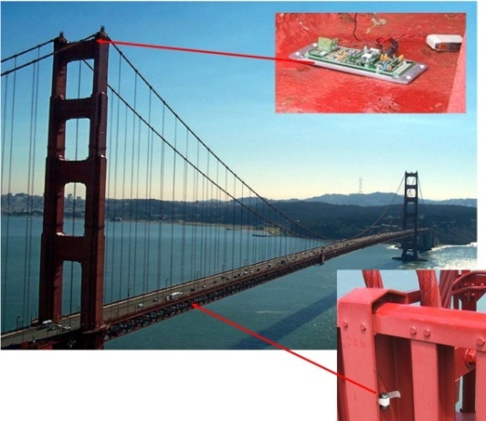
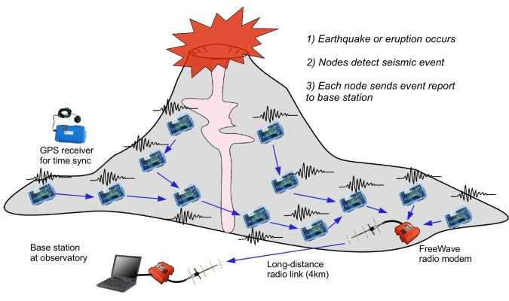
Wireless Sensor Networks
Data Collection and Distributed Control
Smart homes/buildings
Smart structures
Search and rescue
Homeland security
Event detection
Battlefield surveillance
Energy (transmit and processing) is the driving constraint
Data flows to centralized location (joint compression)
Low per-node rates but tens to thousands of nodes
Intelligence is in the network rather than in the devices

Slide 44
Energy-Constrained Radios
Transmit energy minimized by sending bits slowly
Leads to increased circuit energy consumption
Short-range networks must consider both transmit and processing/circuit energy.
Sophisticated encoding/decoding not always energy-efficient.
MIMO techniques not necessarily energy-efficient
Long transmission times not necessarily optimal
Multihop routing not necessarily optimal
Sub-Nyquist sampling can decrease energy and is sometimes optimal!
Notes:
All the sophisticated high-performance communication techniques developed since WW2 may need to be thrown out the window.
By cooperating, nodes can save energy

Slide 45

Where should energy come from?
Batteries and traditional charging mechanisms
Well-understood devices and systems
Wireless-power transfer
Poorly understood, especially at large distances and with high efficiency
Communication with Energy Harvesting Radios
Intermittent and random energy arrivals
Communication becomes energy-dependent
Can combine information and energy transmission
New principles for radio and network design needed.

Slide 46

Distributed Control over Wireless
Automated Vehicles
- Cars
- Airplanes/UAVs
- Insect flyers
Interdisciplinary design approach
Control requires fast, accurate, and reliable feedback.
Wireless networks introduce delay and loss
Need reliable networks and robust controllers
Mostly open problems
: Many design challenges

Slide 47
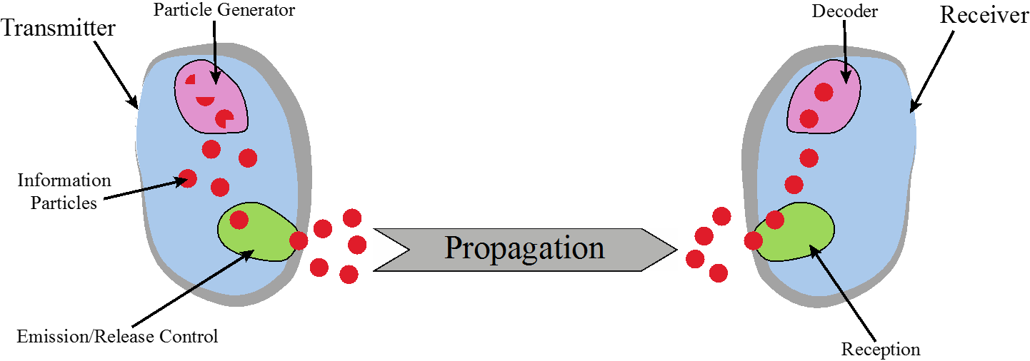
Chemical Communications
Can be developed for both macro (>cm) and micro (<mm) scale communications
Greenfield area of research:
Need new modulation schemes, channel impairment mitigation, multiple acces, etc.

Slide 48


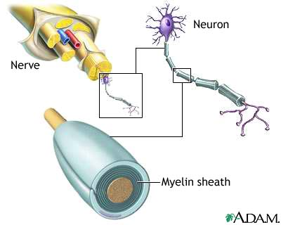
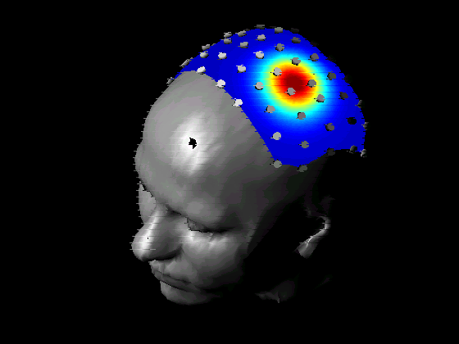
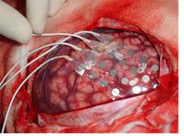
Applications in Health, Biomedicine and Neuroscience
Neuroscience
Nerve network (re)configuration
EEG/ECoG signal processing
Signal processing/control for deep brain stimulation
SP/Comm applied to bioscience
Body-Area
Networks
Recovery from Nerve Damage
ECoG Epileptic Seizure Localization
EEG
ECoG

